Slide 1
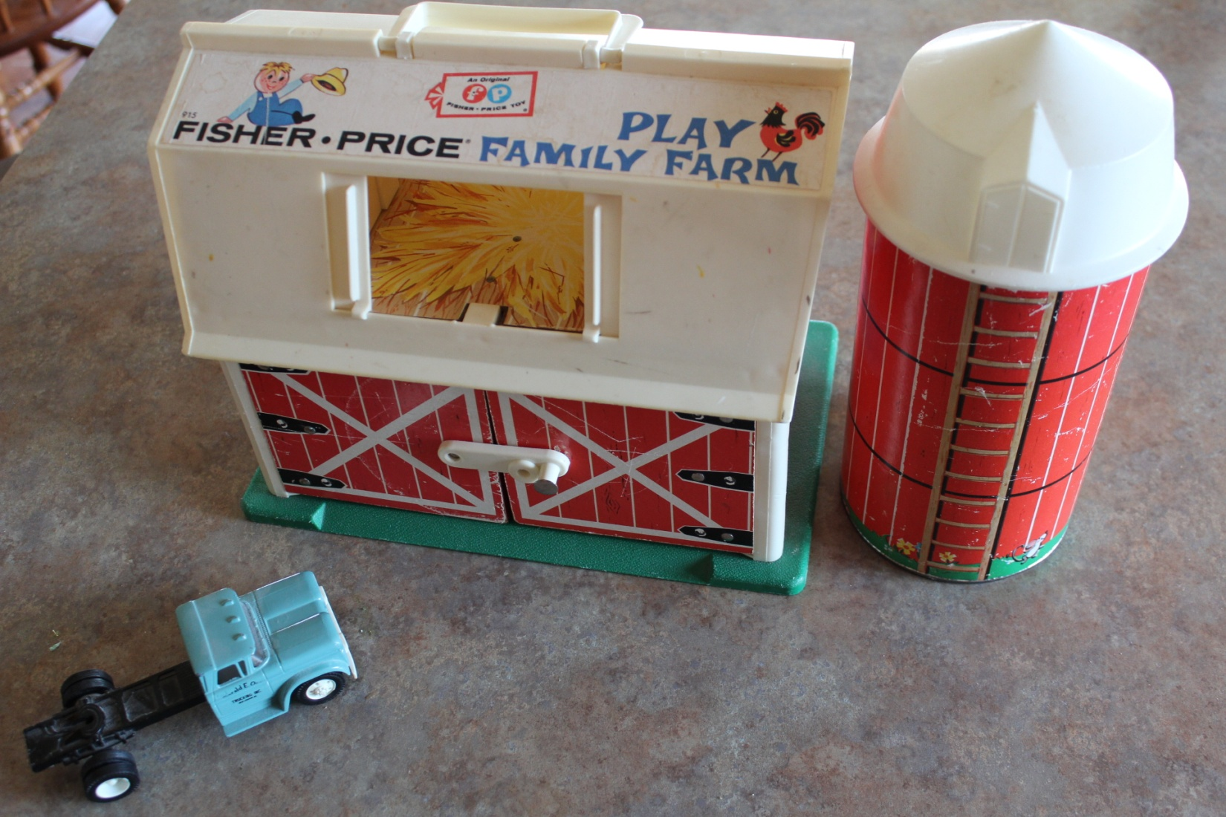
What Is Agricultural Property?
Notes:
Does this building qualify for intensive agricultural equipment storage?

Slide 2
Ag 101 Seminar
Presented By:
MAAO Ag Committee
2014 MAAO Summer Seminars

Slide 3
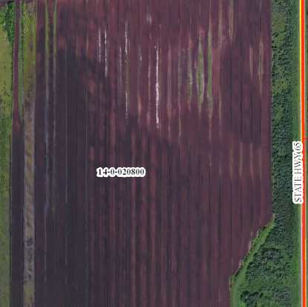
What Is Agricultural Property?
Surely this is ag….
Notes:
Aitkin County photo. This is a peat mine owned by Peat Inc. Their peat is processed and used for golf courses, stadium turf, and horticultural uses. We classify all the dark colored or tilled areas as commercial.

Slide 4
What Is Agricultural Property?
Minnesota Statute 273.13 Subdivision 23 defines agricultural property for property tax purposes in Minnesota. (posted on Revisor of Statutes website)
Minnesota Property Tax Administrator’s Manual Module #3, pages 17 through 24. (Posted on DOR website)
Department of Revenue Letter Manual Classification Section (posted on MAAO website)

Slide 5
Three Points to Consider for Ag Class
1. At least 10 contiguous acres must be used to produce agricultural products in the preceding year.
2. The agricultural product(s) must be defined by MN Statute 273.13 Subd. 23.
3. The agricultural product(s) must be produced for sale.
Exceptions: land enrolled in CRP, RIM, or CREP also typically qualifies for productive ag land. Intensive and exclusive uses also have different criteria and these will be covered later.
Notes:
These are found in the MN Prop Tax Admin Manual

Slide 6
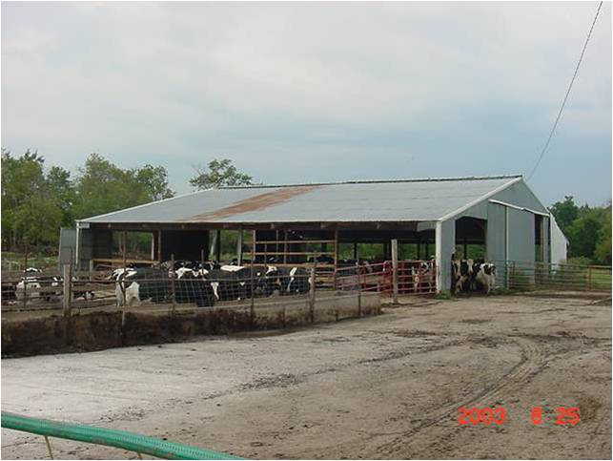
Photo Examples of Ag Products
Livestock Cattle Raised for Meat:
Notes:
Holstein cattle which are actually dairy cattle shown here. These properties and most shown on the slides can vary widely in condition, cost, size and design.

Slide 7
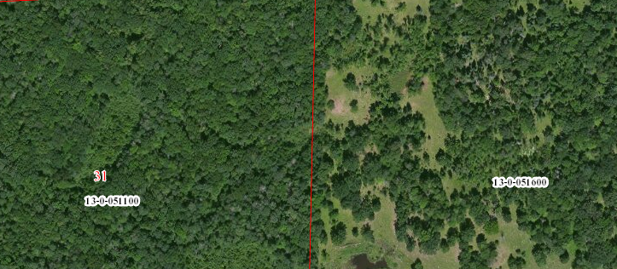
Photo Examples of Each Ag Product
Livestock Pasture: Wooded Land that is Pastured and Non-Pastured
Notes:
Aitkin County photo. Woods on the left are non-pastured. The right area is pastured. Pastured woods is not always plainly obvious by the aerial photo.

Slide 8
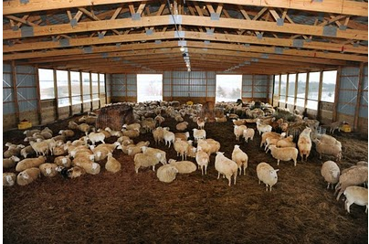
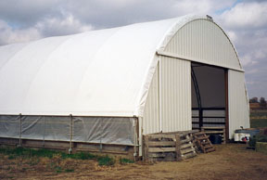
Photo Examples of Each Ag Product
Livestock: Sheep
Notes:
Internet photos of sheep barns. Sheep and goats require more sturdy and shorter fencing than cattle.

Slide 9
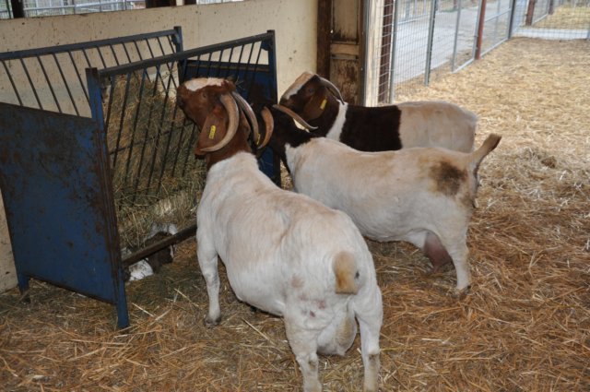
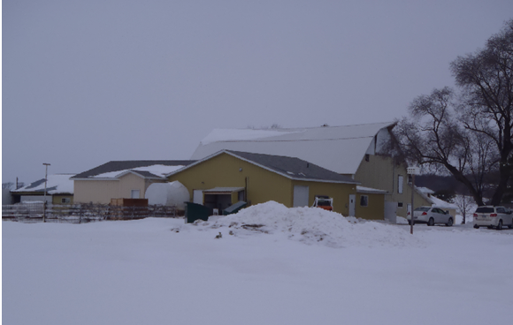
Photo Examples of Each Ag Product
Livestock: Goats
Notes:
Internet photo on left, Stearns County photo on right. Goats feeding on hay on the left. Dairy goat barn on the right.

Slide 10
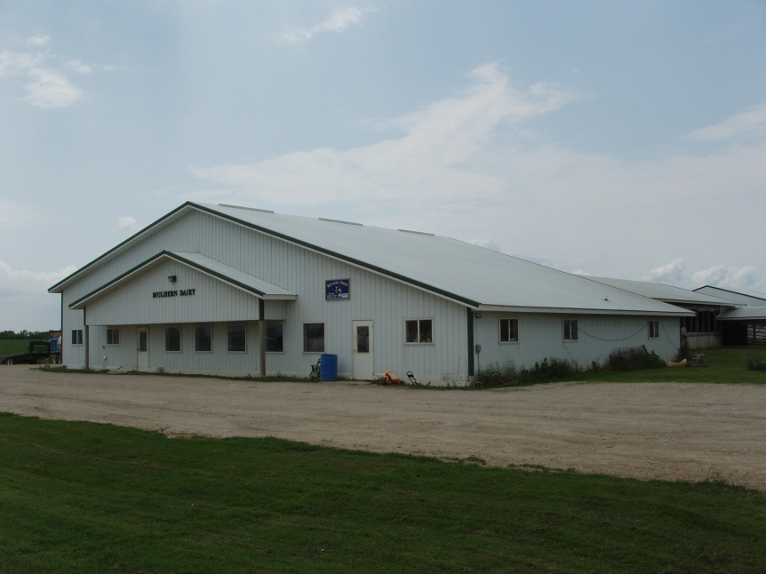
Photo Examples of Each Ag Product
Dairy Animals: Cows raised for Dairy, modern dairy farm:
Notes:
This is a modern dairy parlor. Fillmore County photo.

Slide 11
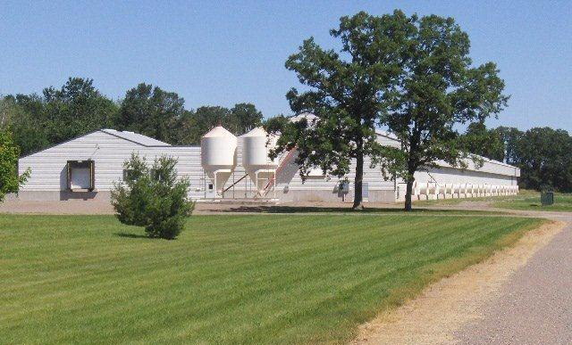
Photo Examples of Each Ag Product
Poultry and Poultry Products: Chicken farm that produces eggs
Notes:
Mille Lacs County photo. This would be a large scale processing facility that houses 75 to 100 thousand laying hens.

Slide 12
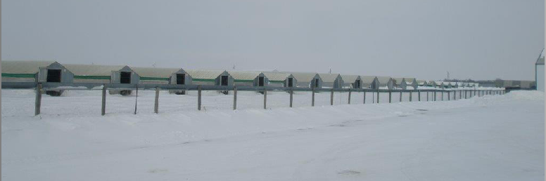
Photo Examples of Each Ag Product
Fur-Bearing Animals: Mink farm
Notes:
Stearns County photo. Mink farms feature several long narrow and short buildings. Minnesota is one of the top mink producing states in the US.

Slide 13
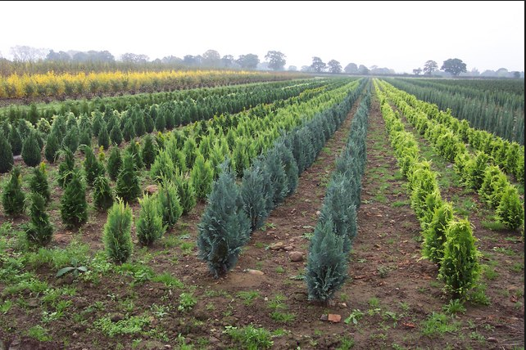
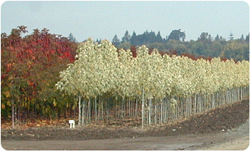
Photo Examples of Each Ag Product
Horticultural and Nursery Stock: Farm that grows seedling trees for the inventory of a local garden center:
Notes:
Internet photos. Different varieties of trees are planted neatly in rows. More variation in these stands than other tree farms.

Slide 14
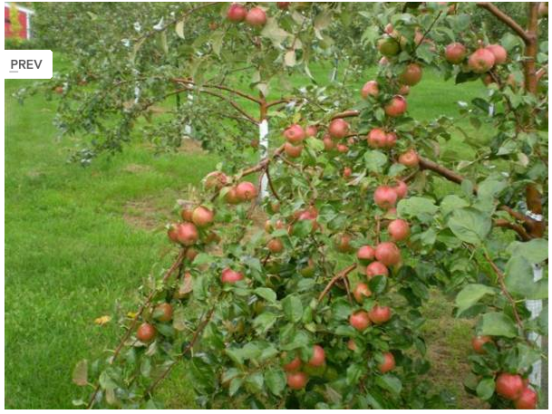
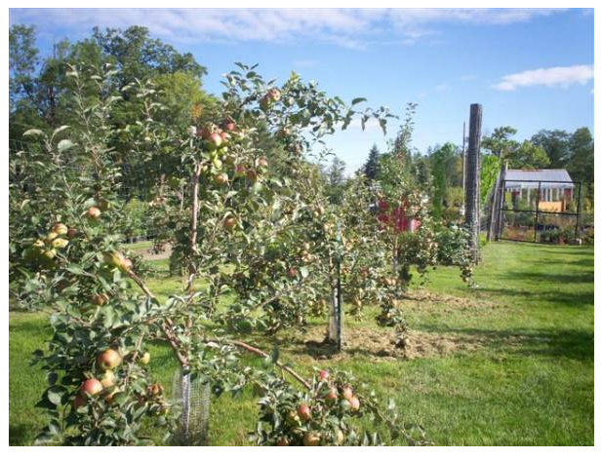
Photo Examples of Each Ag Product
Fruit of All Kinds: Apple Orchard:
Notes:
Aitkin County apple orchard. Sells apples on the farm.

Slide 15
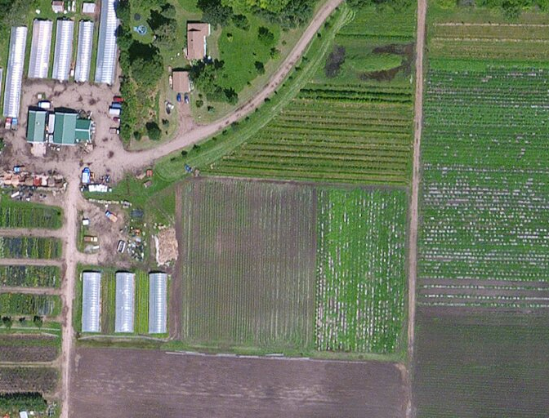
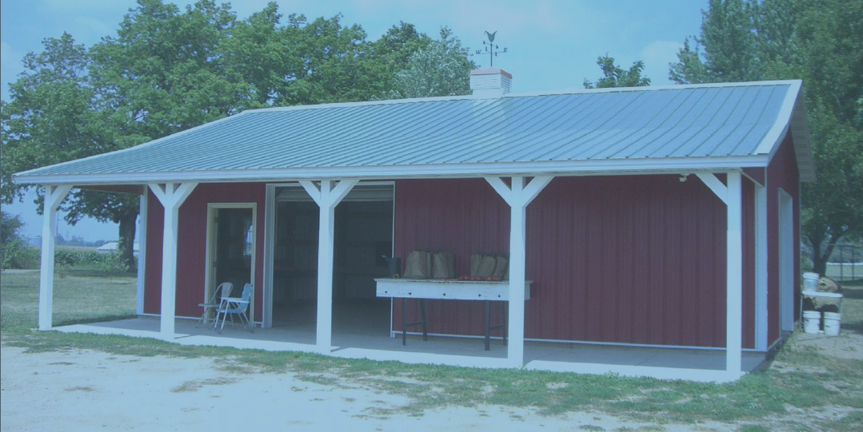
Photo Examples of Each Ag Product
Vegetables: Roadside stand and aerial photo of market farm
Notes:
Carver County roadside stand. Aerial photo in Aitkin County of a large market farm. Note the translucent plastic laid in rows on the fields where vegetables grow.

Slide 16
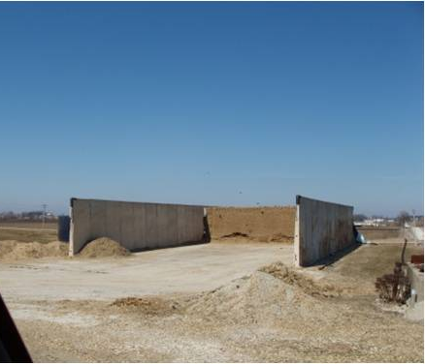
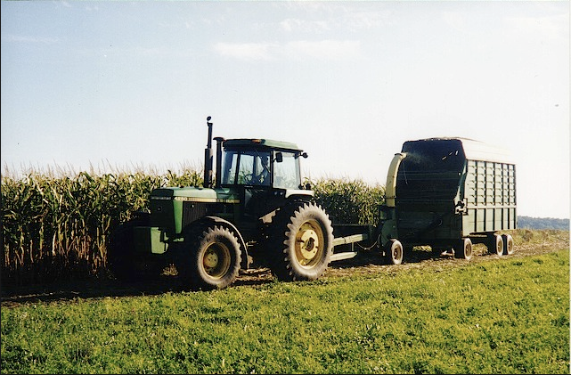
Photo Examples of Each Ag Product
Forage: Property that produces a silage product for livestock feed:
Notes:
Internet photo on left of tractor, chopper and forage box. Fillmore County photo on right. Newer equipment may be self propelled. Modern bunker silo on right.

Slide 17
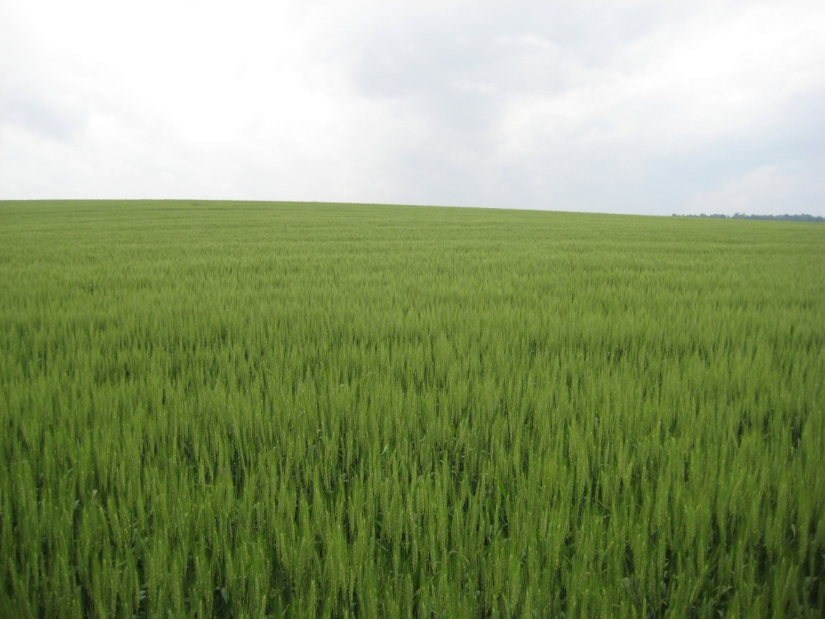
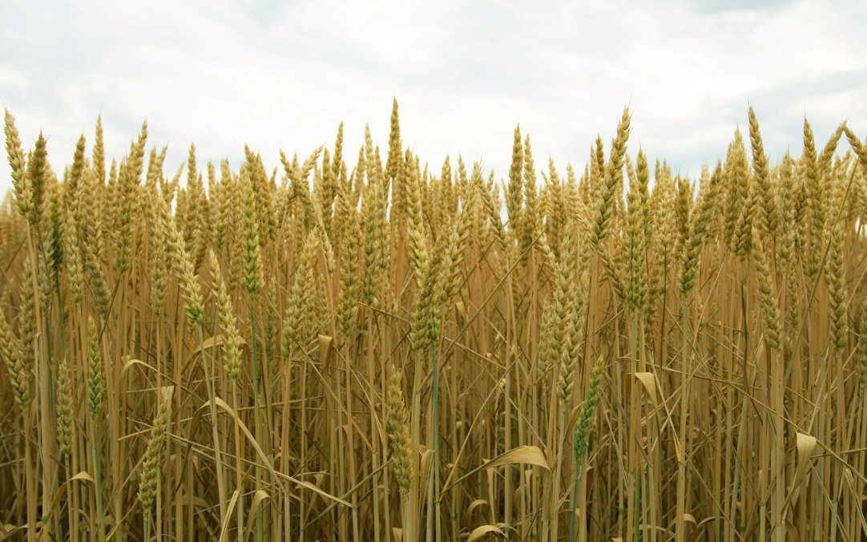
Photo Examples of Each Ag Product
Grains: Wheat
Notes:
Internet photos. Ripe field of wheat on left.

Slide 18
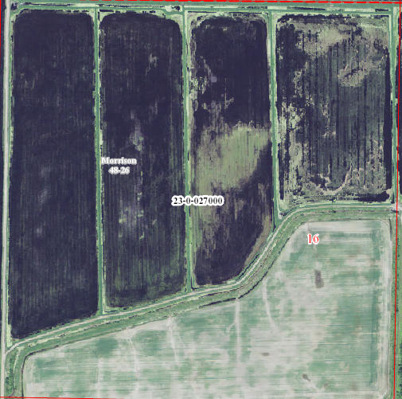
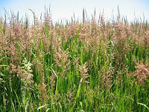
Photo Examples of Each Ag Product
Grains: Wild Rice
Notes:
160 acre parcel that produces wild rice in Aitkin County. Aitkin’s largest farmer by land area is a rice farmer. Fields are diked and flooded at certain times of the year to produce the rice.

Slide 19
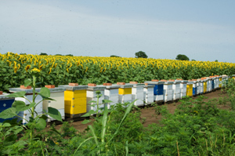
Photo Examples of Each Ag Product
Bees and Apiary Products: Honey production:
Notes:
Photo from U of M website. Sunflower field with dozens of beehives set up nearby. Hives of this volume could possibly qualify for ag classification.

Slide 20
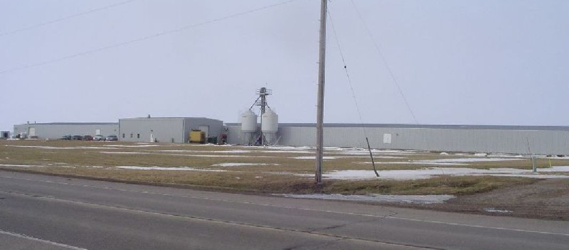
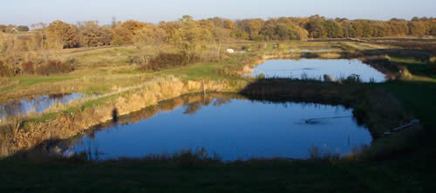
Photo Examples of Each Ag Product
Fish: Fish farming for food (not bait)
Notes:
Indoor fish farm in Renville County. Outdoor fish pond located in Osakis, MN.

Slide 21
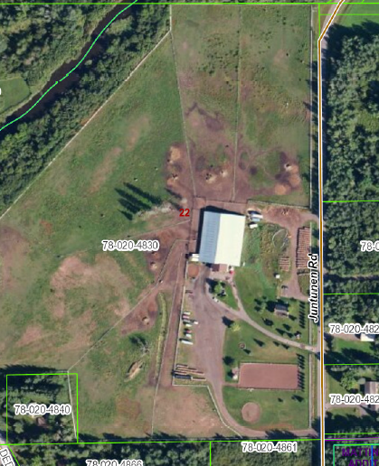
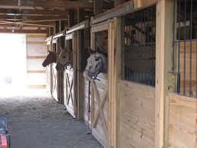
Photo Examples of Each Ag Product
Horse Facility:
Notes:
Aerial photo of a horse boarding property in Carlton County and interior photo of horse boarding from internet.

Slide 22
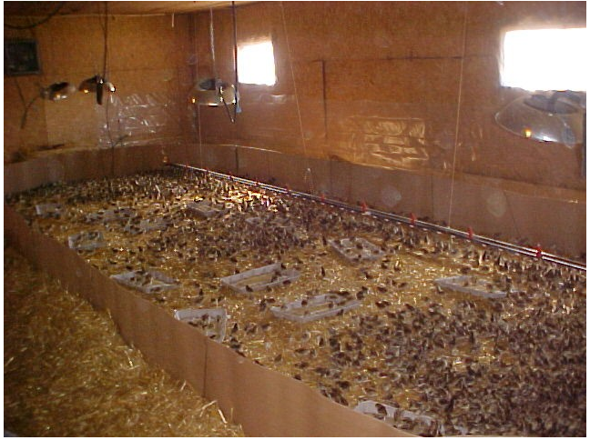
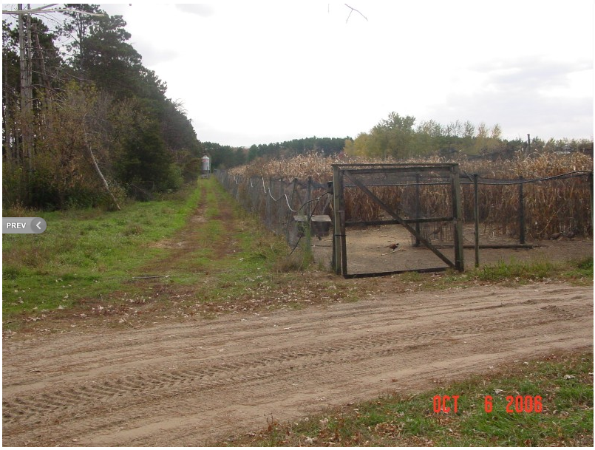
Photo Examples of Each Ag Product
Game Birds and Waterfowl on a Game Farm or Shooting Preserve:
Notes:
Interior and exterior views from the Oakwood Game Farm in Sherburne County. Note the type of fencing and overhead poultry netting that is required to keep birds in.

Slide 23
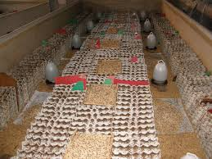
Photo Examples of Each Ag Product
Insects Bred for Animal Food: Cricket Farm
Notes:
From internet. Not sure if any are currently operating in Minnesota?

Slide 24
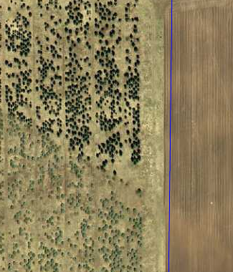
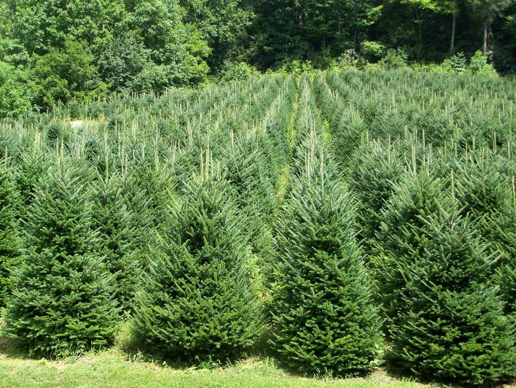
Photo Examples of Each Ag Product
Trees Grown for Sale as a Crop: Christmas Tree Farm
Notes:
Ground view from internet and aerial photo from Pine County.

Slide 25
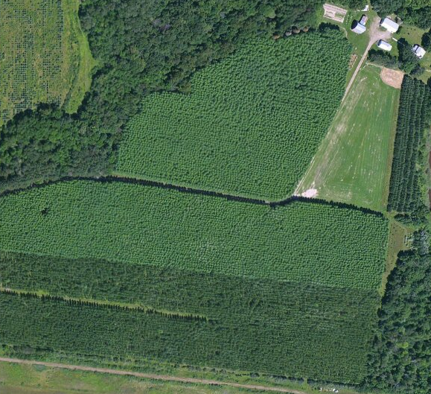
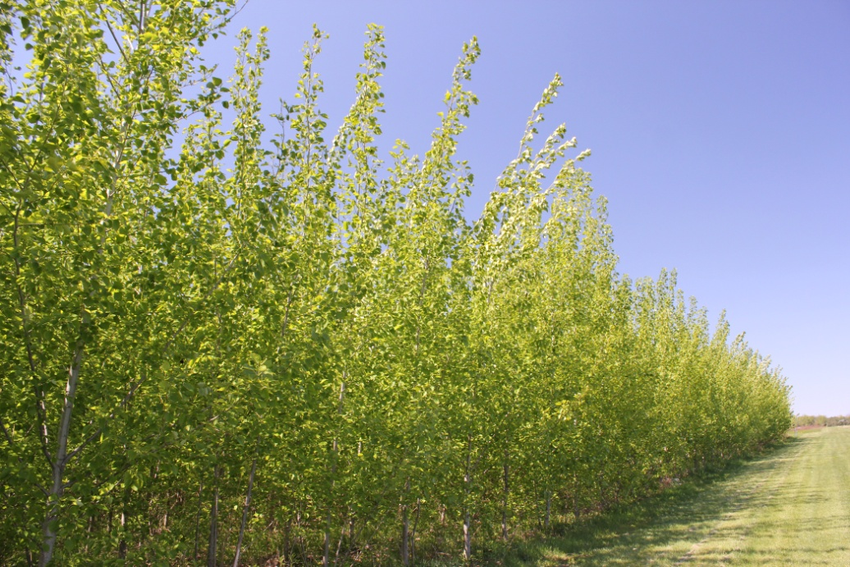
Photo Examples of Each Ag Product
Trees Grown for Sale as a Crop: Hybrid Poplar Plantation
Notes:
Ground view from internet and aerial photo from Aitkin County. The hybrid poplar looks like a carpet on the aerial.

Slide 26
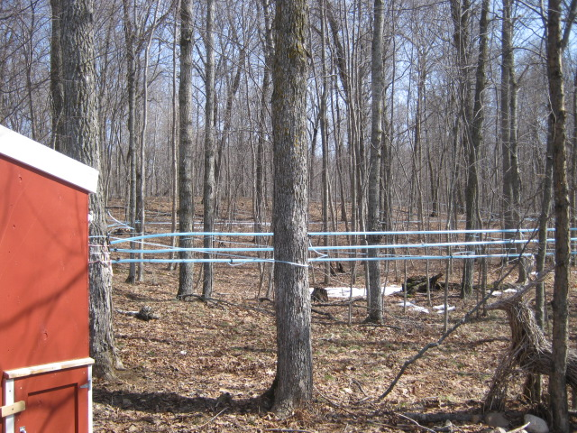
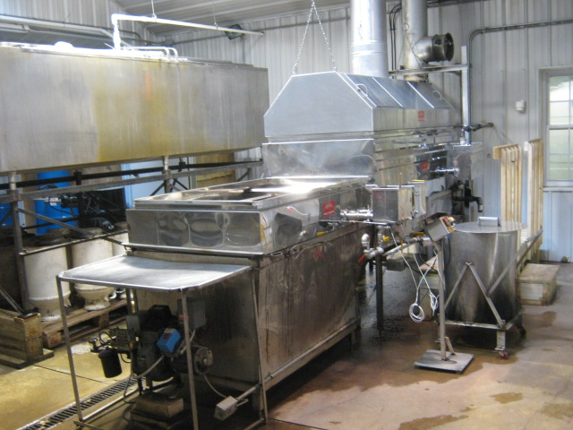
Photo Examples of Each Ag Product
Maple Syrup Production:
Notes:
Aitkin County photos of sap lines running from the sugar maples to a collection shed. Large scale evaporator actually boils the sap into syrup.

Slide 27
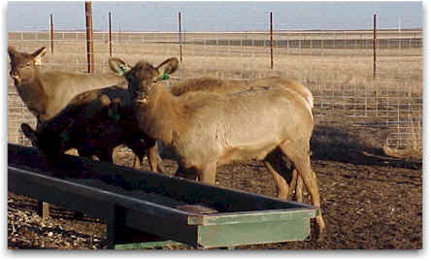
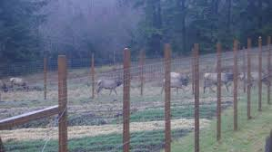
Photo Examples of Each Ag Product
Farmed Wild Animals, Cervidae: Elk Farming
Notes:
Internet photos of elk feeding from a trough and elk fencing. Elk need extremely tall and strong fencing in comparison to regular cattle fencing.

Slide 28
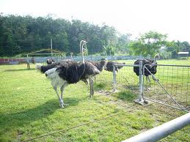
Photo Examples of Each Ag Product
Farmed Wild Animals, Ratitae: Ostrich Farming
Notes:
Internet photo. Any ostrich farms still in MN?

Slide 29
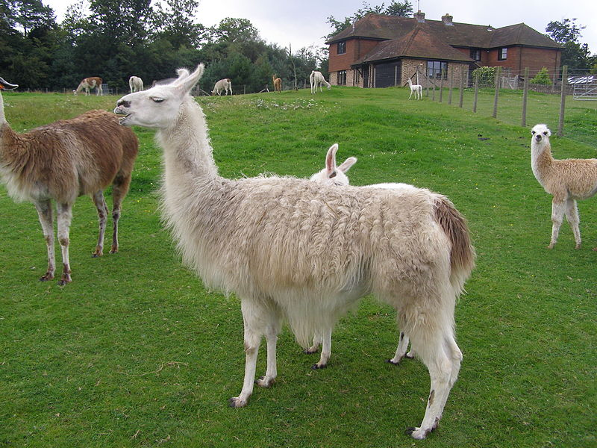
Photo Examples of Each Ag Product
Farmed Wild Animals, Llamas:
Notes:
Internet photo.

Slide 30
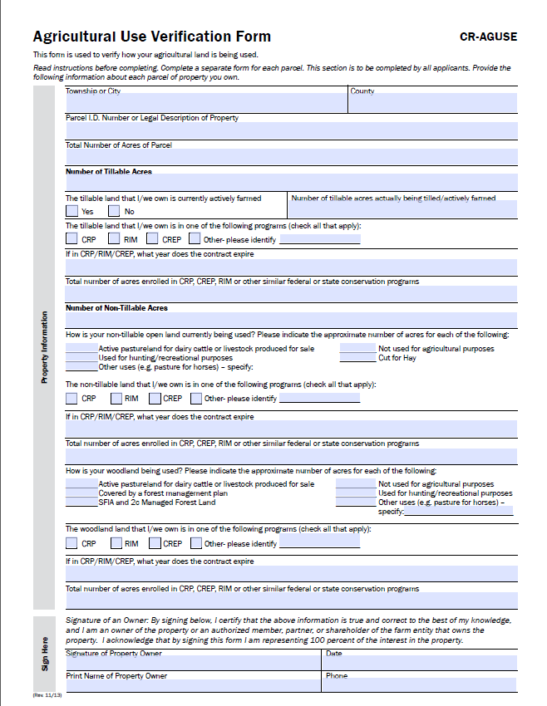
Verification of Ag Class
The Ag Use Verification Form drafted by the DOR:
Notes:
This should be a handout. The newest version is shown. Some counties mail these to every ag property owner.

Slide 31
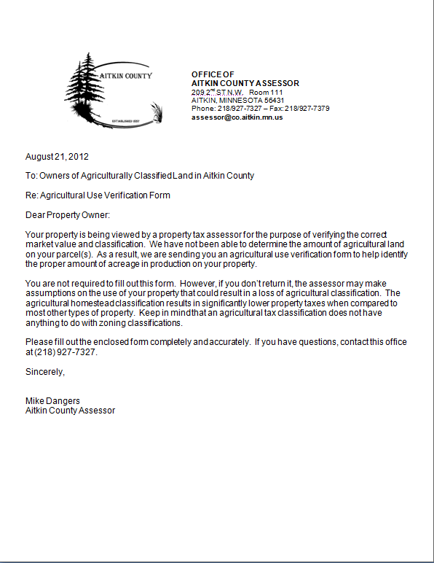
Verification of Ag Class
Example of Cover Letter for an Ag Use Verification Form Mailing:
Notes:
This is a mass mailing letter used in Aitkin County recently. We don’t mail to every ag property, just the ones that are questionable.

Slide 32
Verification of Ag Class
Use of Aerial Photography:
  Current aerial photos and Geographic Information Systems (GIS) mapping are essential tools in verifying most ag class scenarios.
  Physical inspection of the property on the ground is also essential for a full picture of the situation.
  Notice the differences in how a tilled field or a grain field looks in comparison to a swamp or a pasture. We find wooded pasture especially difficult to determine via aerial photography.
Notes:
At this time, do a quick demo of our GIS system. Zoom to an ag parcel that contains tillable, pasture, and swampland.

Slide 33
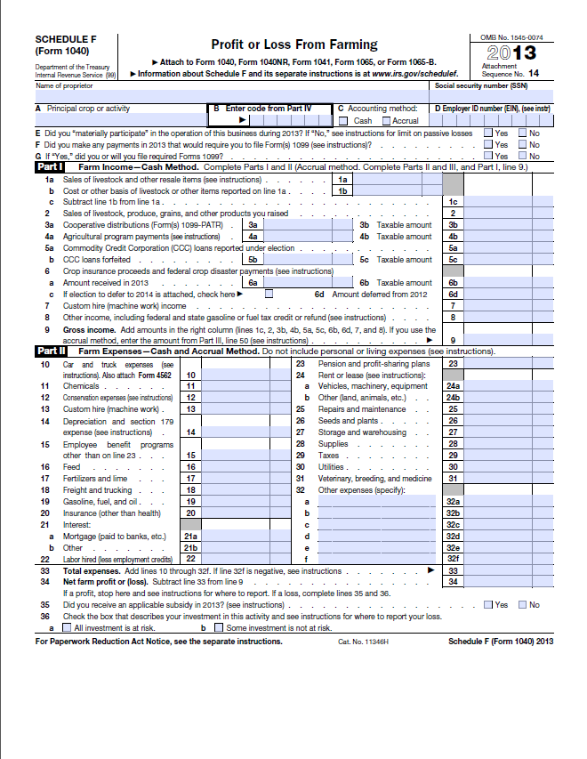
Verification of Ag Class
Example of a Schedule F for an ag property:
Notes:
Copy of a schedule F from the IRS website. Real farmers will know what this is.

Slide 34
Intensive Ag Use Operations
Livestock or poultry confinement property are considered ag class regardless of the size of the land. These properties typically house at least thousands of birds or hundreds of cattle per building.
MN Statutes and DOR Manuals do not specify a minimum number of animals or animal units to qualify for ag class.
Assessors must use their best judgment and ask questions of other experienced assessors for help.

Slide 35
Exculsive Use Qualifies as Ag Class
If the entire parcel is used as productive agricultural land (2a land), then the parcel should be classified as agricultural even if it is less than 10 acres.
However, if this is the only productive ag land on the farm, then it does not qualify.

Slide 36
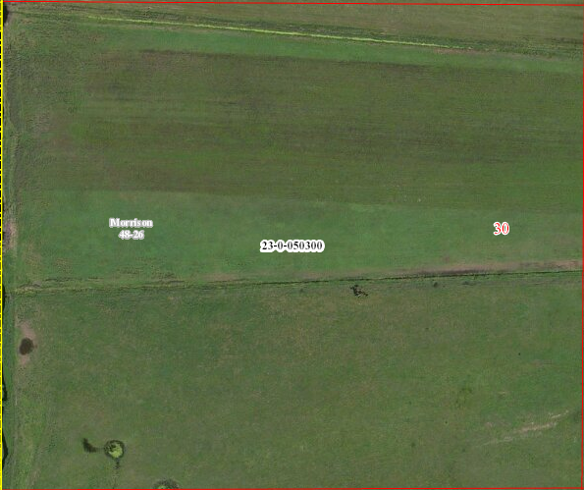
Aerial Photo Example of Exclusive Use
Notes:
This parcel is all hay land in Aitkin County.

Slide 37
Ag Class on Properties Less Than 11 Acres Improved with a Res Structure
The following four property types can have ag in this situation:
  Intensive grain drying or grain storage property.
  Intensive storage of ag equipment on a property that supports the same owner’s farm operation.
  Intensive nursery stock production (split classify residential and agricultural so only productive land is ag).
  Intensive fruit or vegetable market farming (also split classify res and ag class so only productive land is ag).

Slide 38
Minimal Ag Production
Keep in mind that ag production for personal use does not result in ag class for property taxes.
When these scenarios come up, discuss them with the following individuals:
  Your county assessor
  Experienced appraisers in your office
  Your regional representative

Slide 39
Minimal Ag Production
Consider using the following resources:
  Department of Revenue Letter Database
  Minimal ag use policy in your office
  Examples to refer to in your office
  Guidelines or questions to ask property owners

